Slide 1

Banking System - UML Design
Software Modelling with Use Case, Class, and Sequence Diagrams
Group Members: [Names]
Date: February 2026

Slide 2

Chapter 1
System Overview: The Digital Core of Modern Banking
The Banking System is an intricate digital infrastructure designed to efficiently manage diverse financial operations. It acts as the backbone, enabling seamless transactions and maintaining financial records with precision and security.
Key functions include:
Account Management (opening, closing, updating)
Deposits and Withdrawals (cash and cheque)
Fund Transfers (between accounts)
Loan Processing (applications, approvals, repayments)

Slide 3




Chapter 2
Key Actors: Interacting with the Banking System
Understanding the various individuals and systems that interact with the banking system is crucial for a comprehensive UML design. Each actor has distinct roles and access levels, driving specific use cases within the system.
Customer
Bank Teller
Administrator
ATM Machine
Individuals holding accounts and performing transactions via various channels.
Bank employees who process customer transactions and verify identities.
Personnel responsible for system management, configuration, and report generation.
An automated self-service terminal for basic banking operations.

Slide 4
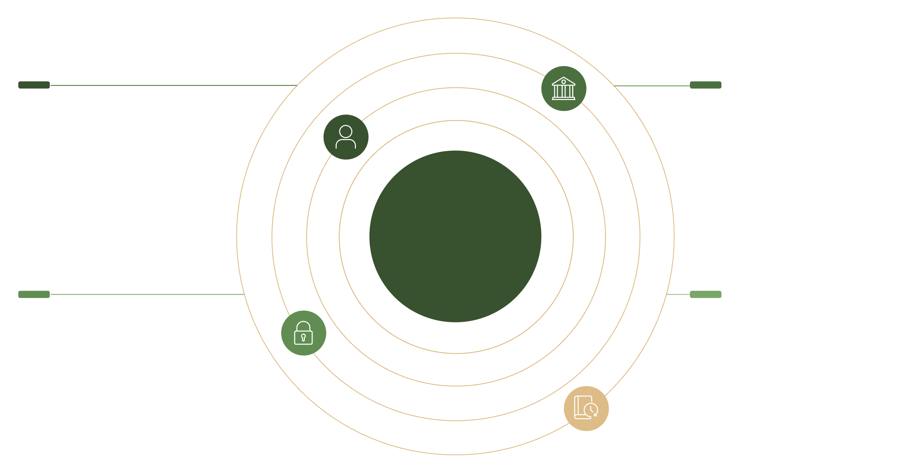

Chapter 3
Use Case Diagram: Mapping System Functionality
This diagram provides a high-level view of how actors interact with the banking system, detailing the functions they perform. It clearly illustrates the scope and primary functionalities from a user's perspective.
Account Management
Financial Operations
Create, update, close accounts
Deposits, withdrawals, transfers, loans
UML Use Case Diagram
Authentication (<>)
Balance & History (<>)
Required for all financial actions
Transaction history extends balance view
The diagram captures the breadth of interactions, from a customer's basic transactions to an administrator's complex system management tasks. It serves as a foundational blueprint for understanding user requirements.

Slide 5

Deeper Dive into Use Case Relationships
Security First: Every financial operation, such as depositing or withdrawing funds, explicitly includes an authentication step, ensuring secure access and transaction integrity.
ATM Limitations: The ATM machine supports a specific subset of operations: deposit, withdraw, and balance inquiry, reflecting its self-service nature.
Teller Capabilities: Bank Tellers have the authority to act on behalf of customers, performing various transactions and providing assistance.
Administrative Control: Administrators engage in distinct management-focused use cases, separate from direct customer interactions, such as managing user accounts and generating system reports.
Enhanced Features: The Transaction History use case extends the Balance View, offering a more detailed look into past financial activities.

Slide 6
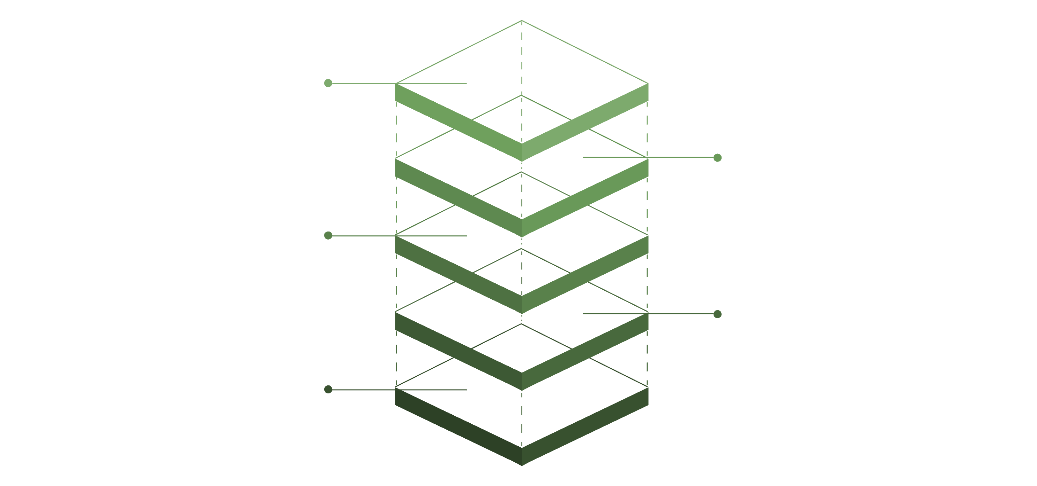
Chapter 4
Class Diagram: Structuring the Banking System
The Class Diagram outlines the static structure of the banking system, identifying the classes, their attributes, methods, and relationships. It is essential for defining the system's data model and foundational architecture.
Key Associations
Customer 1..* Accounts; Account 1..* Transactions
Bank Entity
Bank aggregates branches and services
Transactions & Loans
Transaction and Loan classes shown
Account Hierarchy
Account, SavingsAccount, CheckingAccount
User Hierarchy
User, Customer, BankTeller, Admin
This diagram serves as a blueprint for developers, guiding the implementation of the system's core components and ensuring a robust, scalable design.

Slide 7
Class Diagram: Deconstructing Relationships
User Hierarchy
Account Specialisation
Customer-Account Linkage
Account-Transaction Recording
The User class serves as a base, with specialised subclasses like Customer, BankTeller, and Admin inheriting common properties and behaviours. This ensures code reusability and a clear organisational structure.
Similarly, the Account class is extended by SavingsAccount and CheckingAccount, each with unique attributes and rules specific to their account types.
A crucial Association exists where a Customer can own multiple Accounts (a one-to-many relationship), meticulously tracking financial assets.
Each Account accurately records numerous Transactions (also a one-to-many relationship), forming a comprehensive audit trail of all financial activities.
These relationships form the backbone of the banking system's data integrity and operational logic, directly mapping to how data might be stored in database tables.

Slide 8

Chapter 5
Sequence Diagram: Visualising Fund Transfer
The Sequence Diagram illustrates the dynamic behaviour of the system by modelling the interactions between objects in a time-ordered manner. Here, we focus on the complex, yet common, "Fund Transfer" process.
Authenticate
Validate Account
Process Transfer
Notify Parties
This diagram provides a step-by-step visualisation, revealing how different system components collaborate to complete a single, critical operation, from initial request to final confirmation.

Slide 9





Dissecting the Fund Transfer Flow
The fund transfer process is a multi-stage operation, carefully orchestrated across several system participants to ensure security, accuracy, and timely completion.
1. Authentication Phase
The customer initiates the transfer by logging into the mobile app. Their credentials are sent to the Authentication Service for validation, ensuring only authorised users can proceed.
2. Validation Phase
The Account Service verifies the sender's balance and checks the validity of the recipient's account. This prevents transactions with insufficient funds or incorrect details.
3. Execution Phase
Upon successful validation, the Transaction Service debits the sender's account and credits the recipient's account. These operations are typically atomic to maintain data consistency.
4. Confirmation & Notification
Finally, the mobile app displays a transaction receipt, and the Notification Service dispatches an email or SMS to both sender and recipient, confirming the successful transfer.
5. Error Handling
In cases like insufficient funds, an alternative flow is triggered. The customer is notified, and the transaction is gracefully aborted, ensuring system integrity.

Slide 10
Chapter 6
Conclusion: The Power of UML in Software Design
UML offers a visual, structured approach to software design, crucial for clarity and collaboration.
Use Case Diagrams: Define functional requirements from an actor's perspective, answering "what" the system does.
Class Diagrams: Illustrate the system's static structure, answering "how" it's organised internally.
Sequence Diagrams: Model dynamic behaviour and object interactions over time, detailing event sequences.
Preventative Measures: Modelling before coding significantly reduces errors and saves valuable development time.
By employing various diagram types, we gain multi-faceted insights into complex systems.
Mastering UML enables robust, maintainable software solutions.

